Slide 1
Disease Risk from Daily Habits
Info 523
Dec.10th
Yifan Zhang
Olivia Dodge

Slide 2

Table of Contents
Introduction
Models
Performance Evaluation
Conclusion
Q&A

Slide 3
Dataset
Project Overview
10,000 observations
48 features
Motivation
Explore the relationships among lifestyle choices, physical indicators, demographics, and psychological factors can help detect potential healthy risks. The project is aim to transform high-dimensional raw data into useful insights to help make informed decisions in health-related field.
30 numeric variables:
age, blood_pressure, screen time
18 character variables:
gender, diet type, access to insurance
healthy status

Slide 4
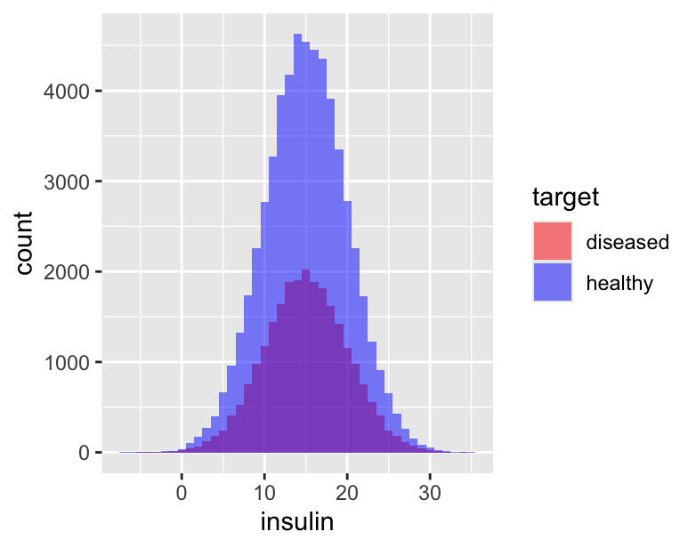
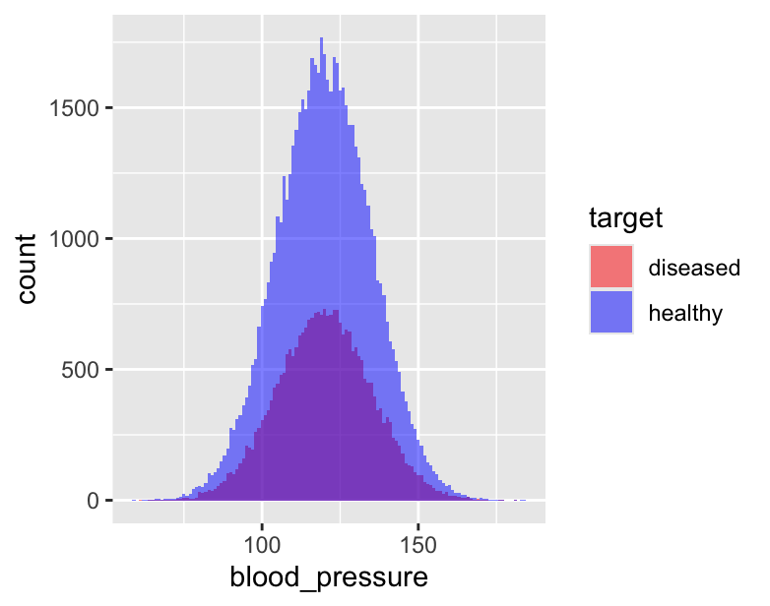
Distributions

Slide 5
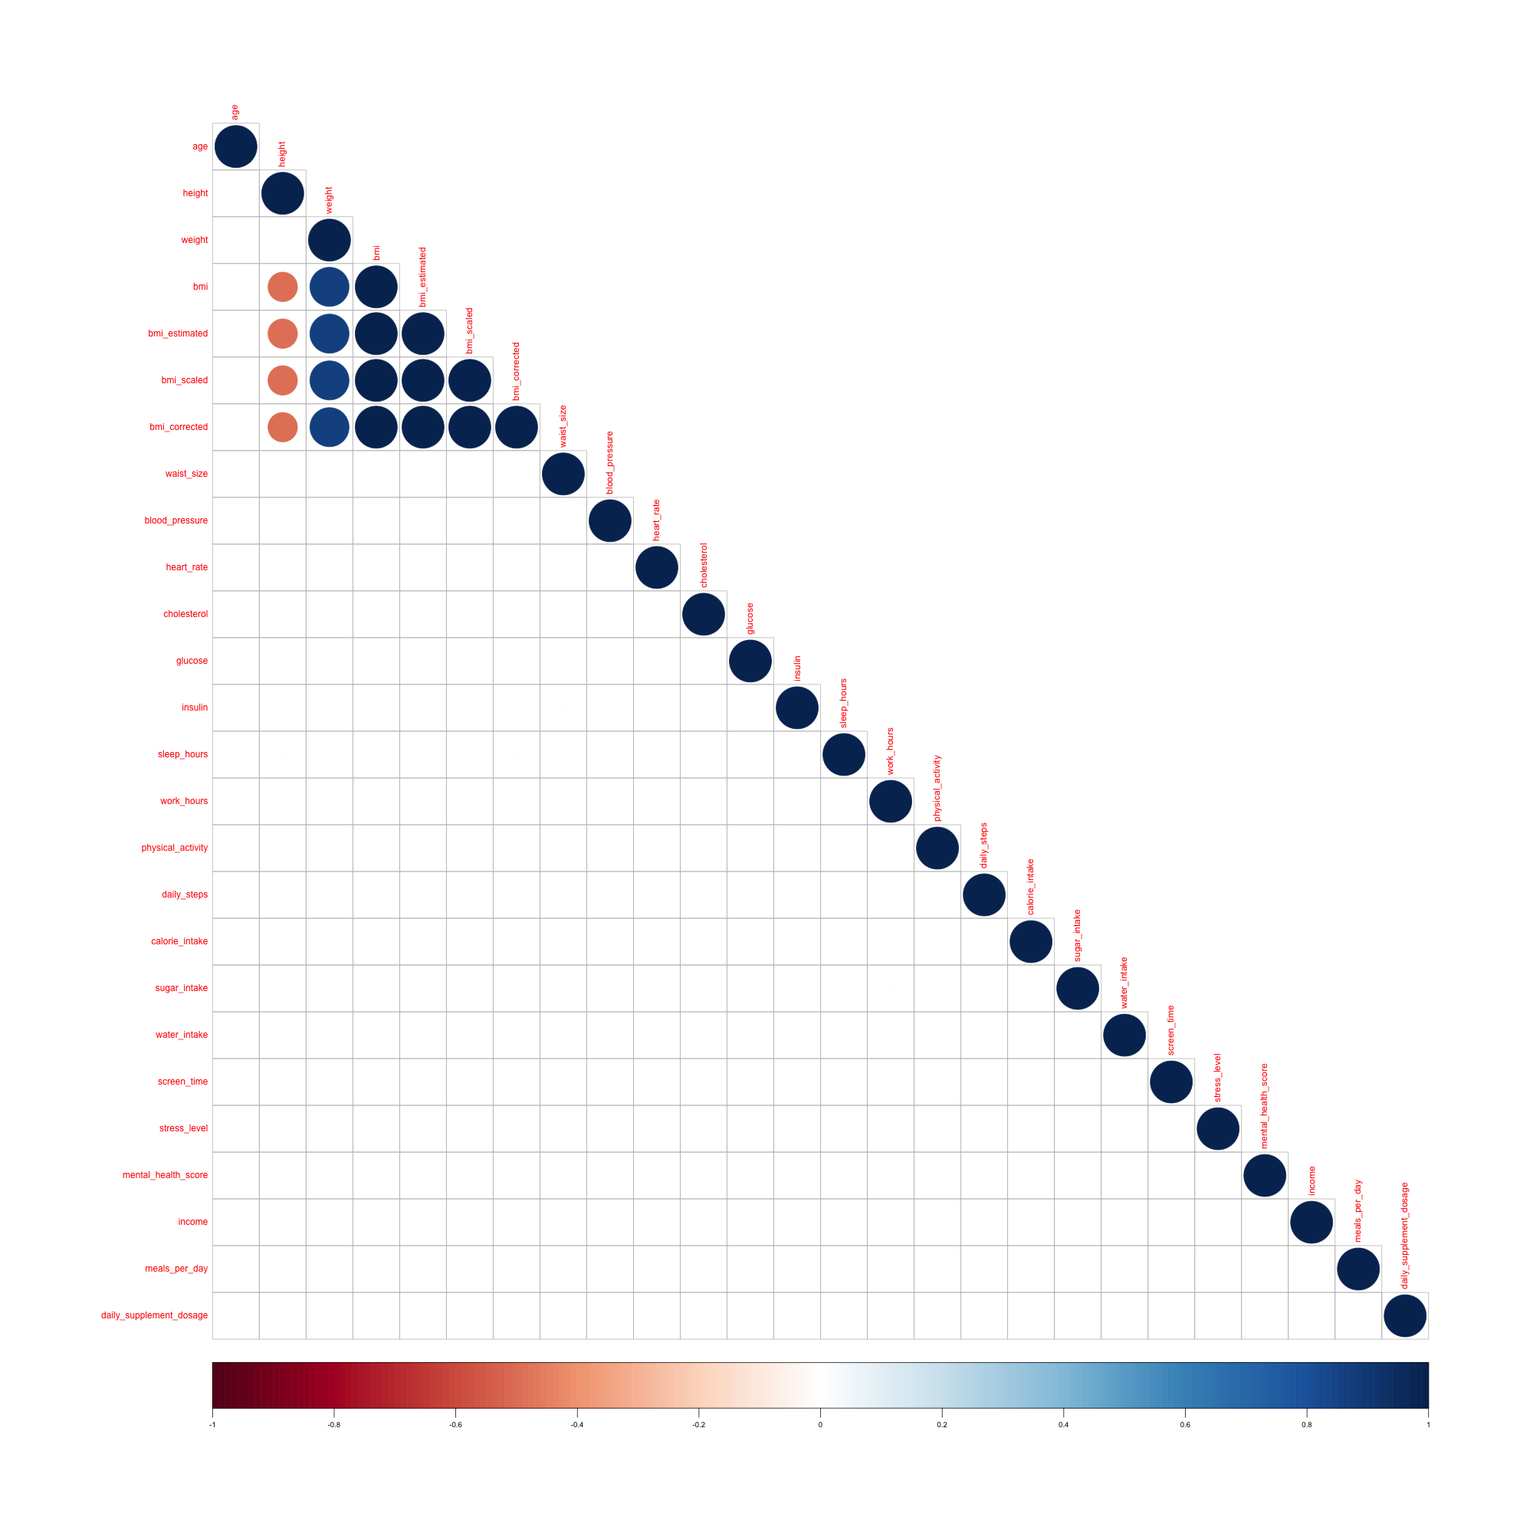
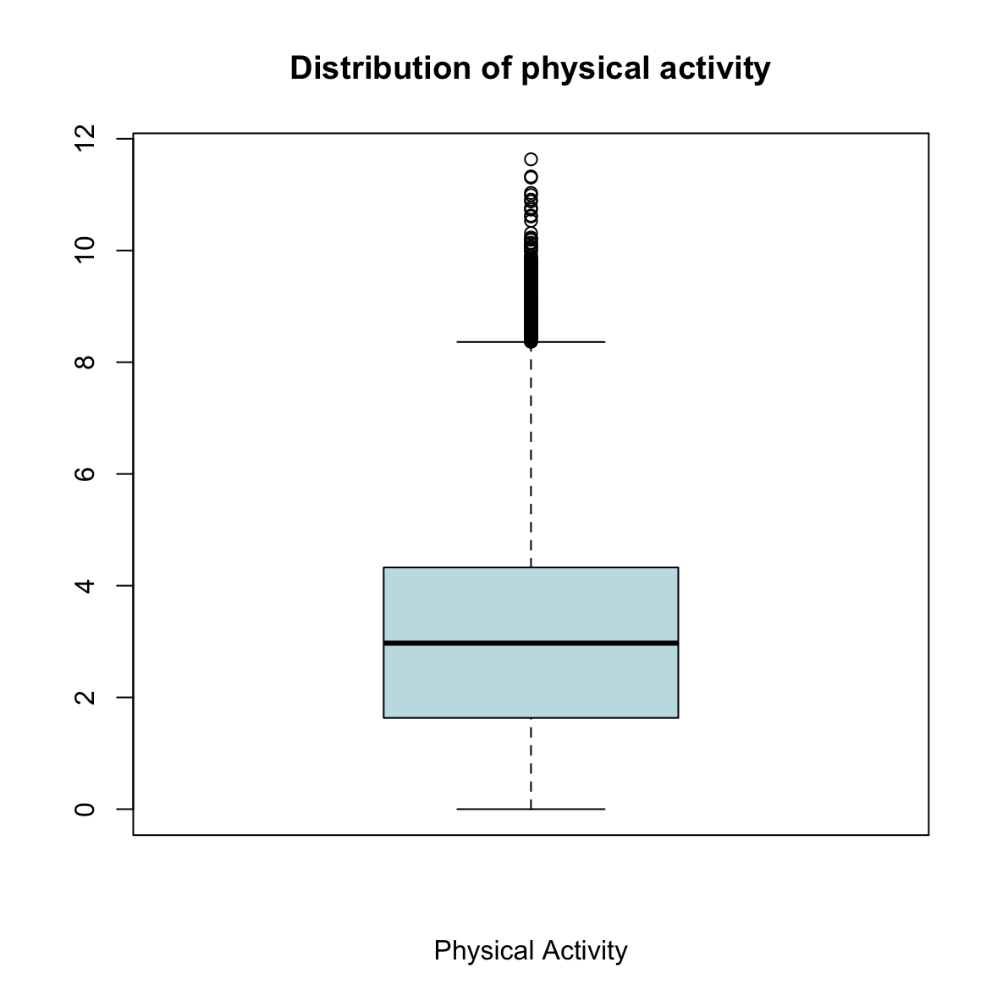
Descriptive statistics
Dec.10th

Slide 6
Data Preprocessing
Highly correlated features
Missing values
Discretization of numeric variables
Label encodings

Slide 7
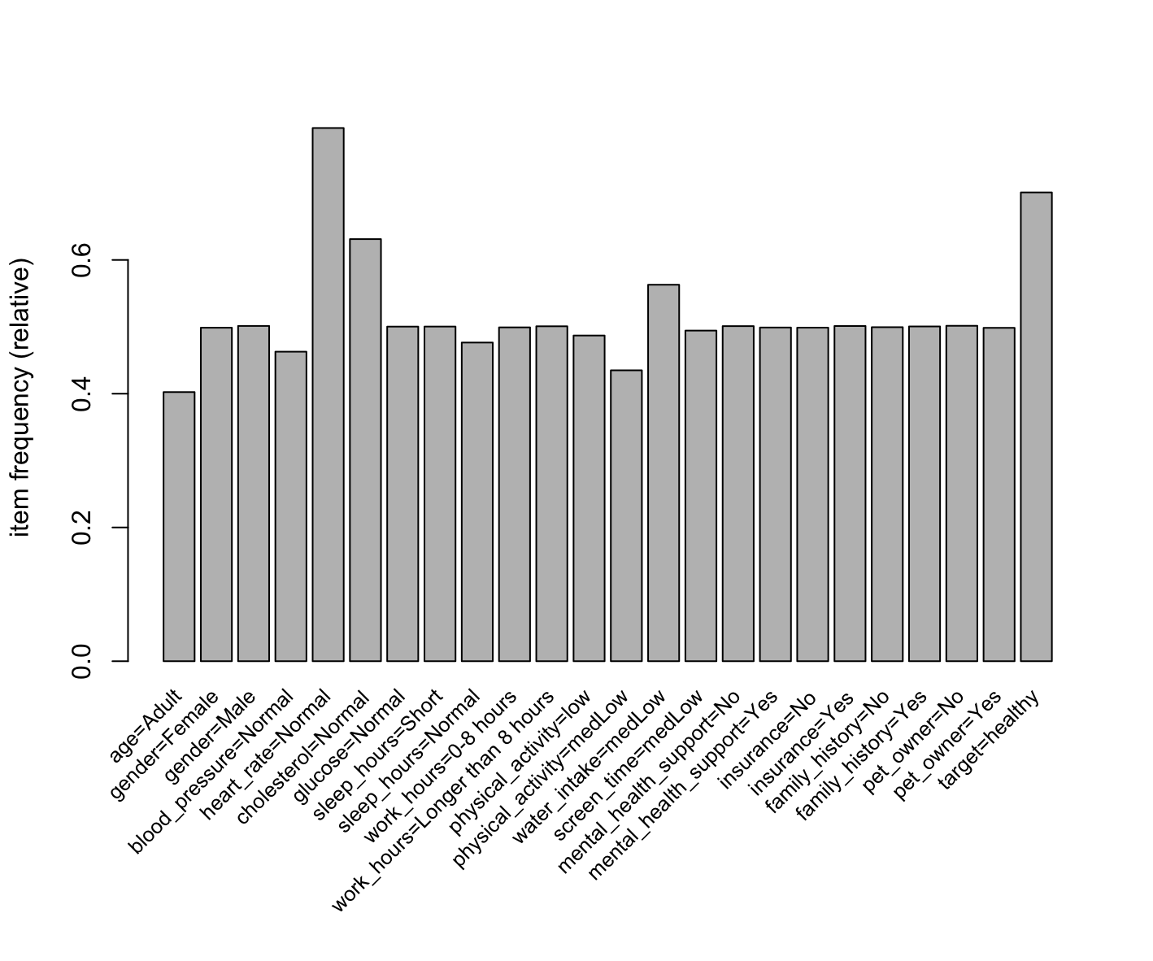
Association Rule Mining
Glucose level, heart rate and cholesterol level
Family history → cholesterol level
Mental health support not that important related to glucose level, heart rate and cholesterol level 😲
THE UNIVERSITY OF ARIZONA

Slide 8
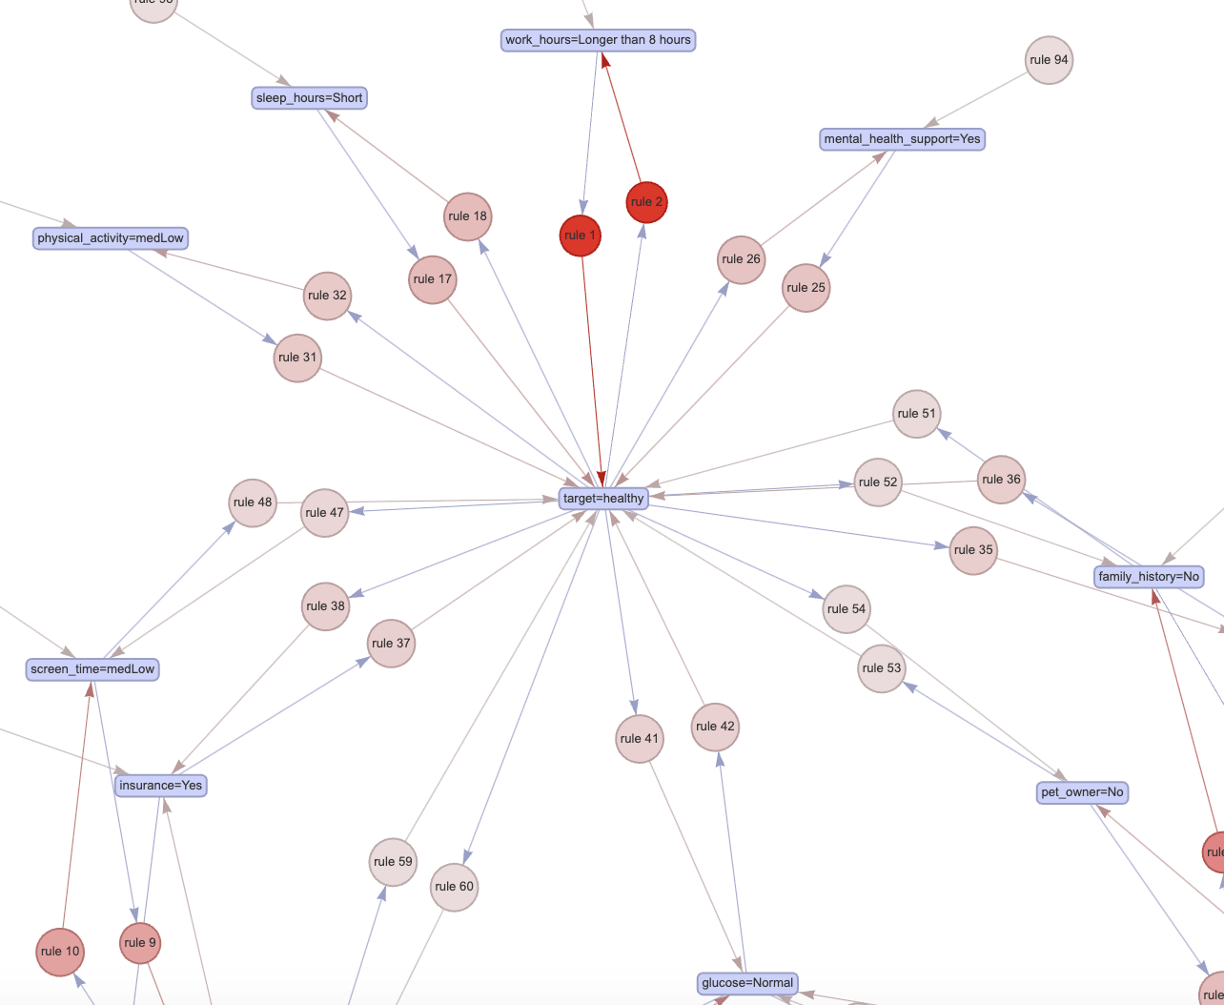
Association Rule Mining
Normal glucose level, no family history, insurance access
Mental health support: YES!
Median low screen time
Not pet owner
THE UNIVERSITY OF ARIZONA

Slide 9
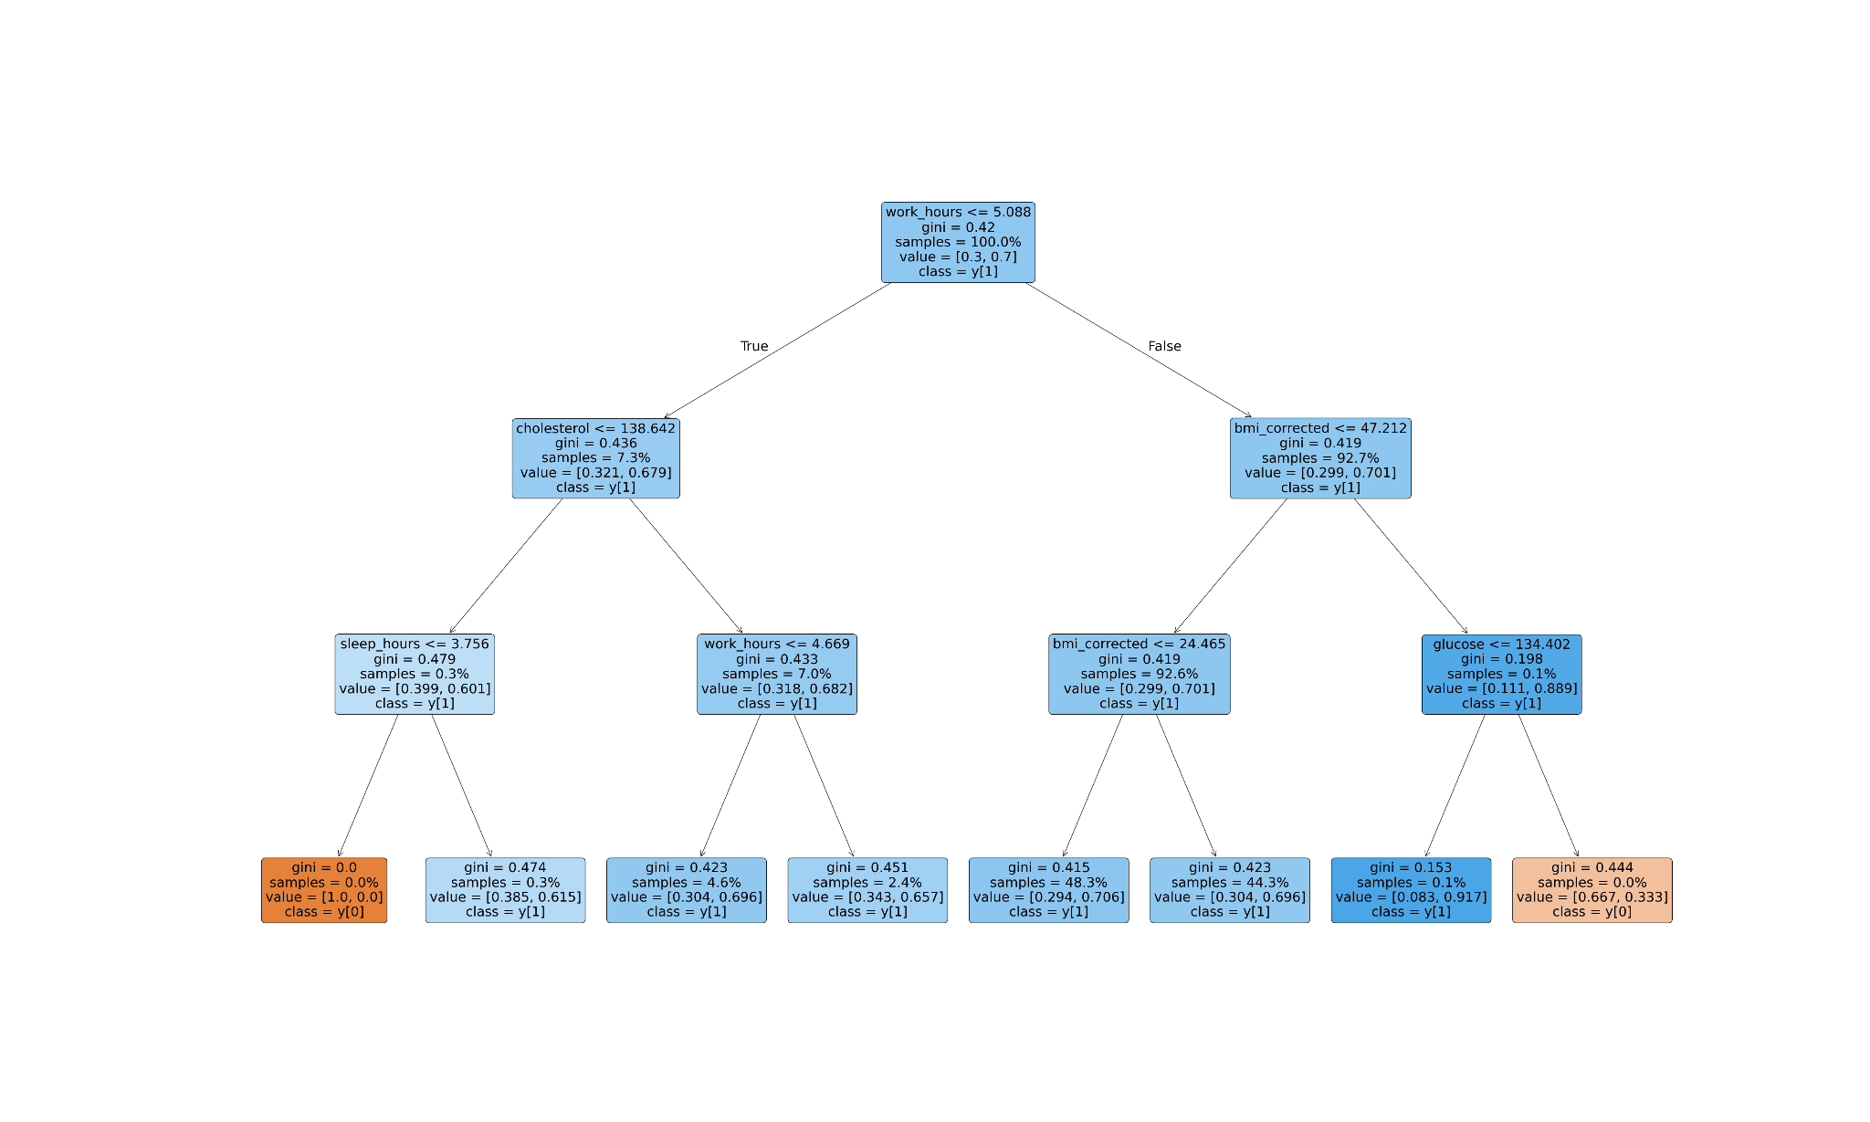
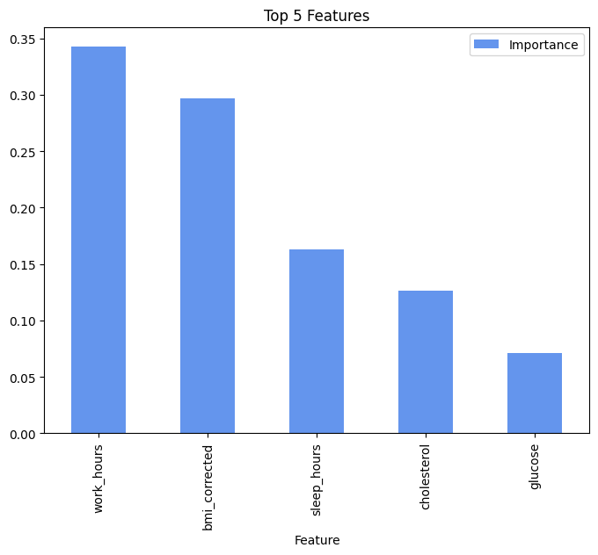
Decision Tree
Classification tree
PRESENTATION TITLE | THE UNIVERSITY OF ARIZONA

Slide 10
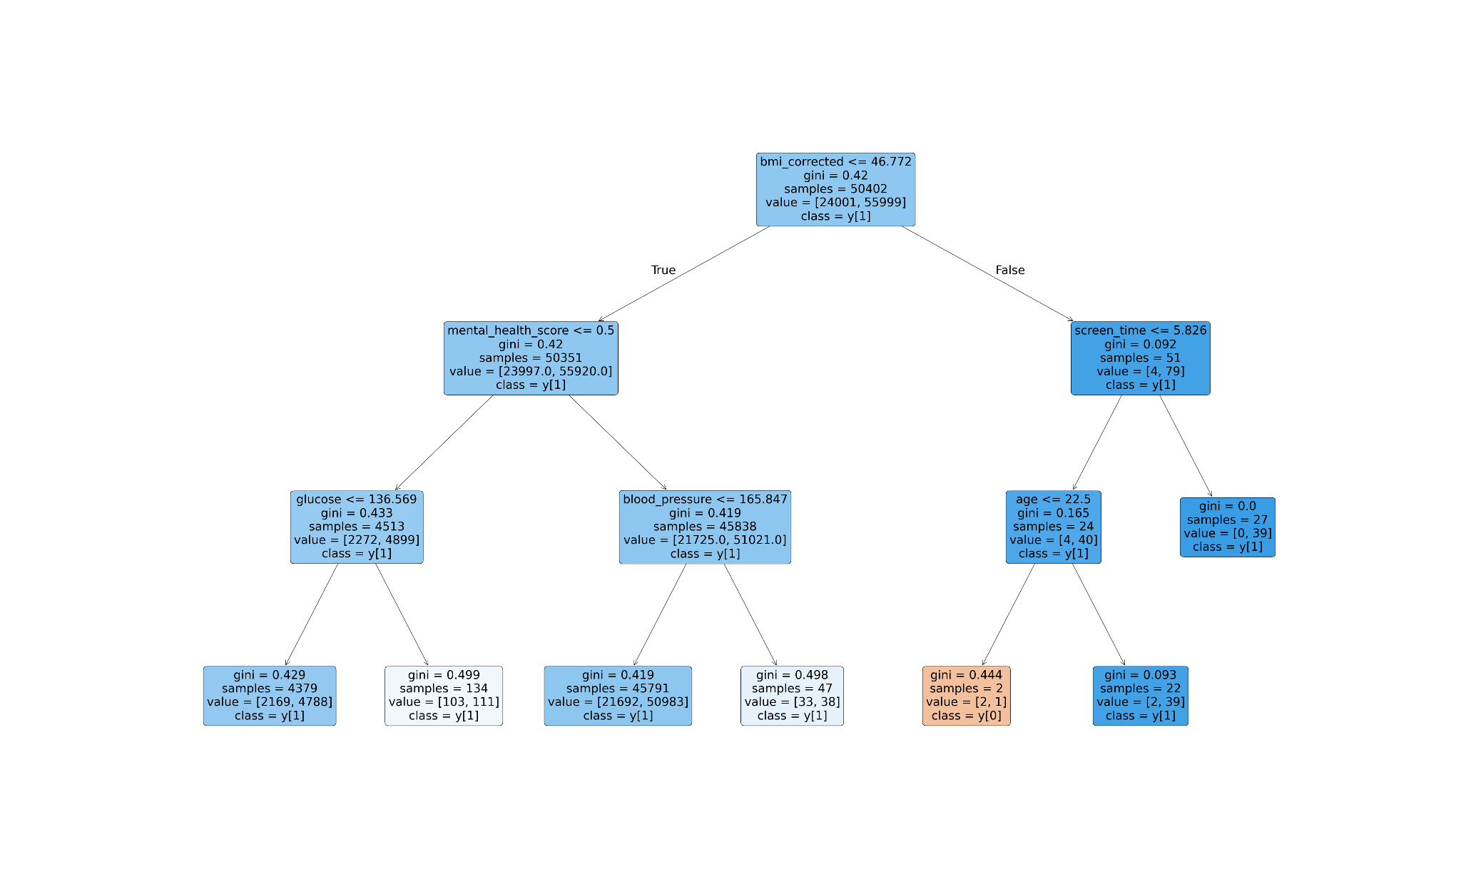
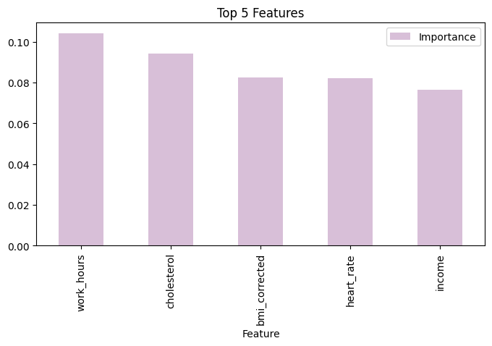
Random Forest
PRESENTATION TITLE | THE UNIVERSITY OF ARIZONA

Slide 11
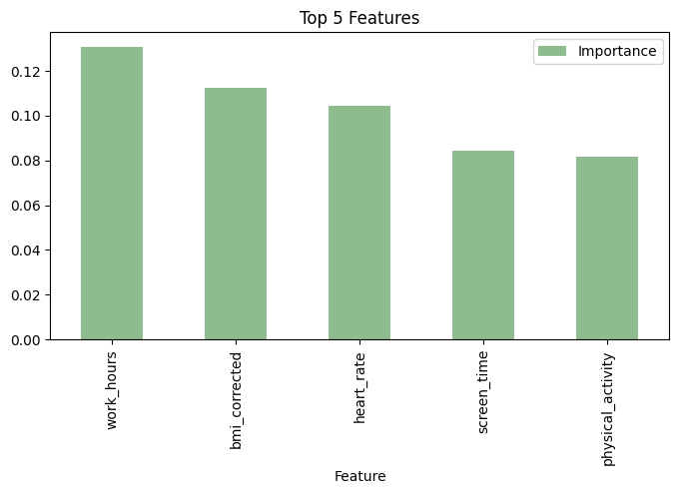
Gradient Boosting
Hyperparameter Tuning (RandomizedSearchCV)
n_estimator
max_depth
min_samples_split
min_samples_leaf

Slide 12
Performance Evaluation
 | Accuracy | F 1 score
Decision Tree | 0.70675 | 0.828162
Random Forest | 0.7067 | 0.828147
Gradient Boosting | 0.7065 | 0.83

Slide 13
Clustering Methods
High dimensional and heterogeneous data
Overlapping patient characteristics
No clear ground truth for validation
Outliers and varying feature scales
Used K-means clustering, hierarchical clustering, and Gaussian mixture model
Notes:
Not a good method for clustering this dataset
Highly correlated variables
Assumes spherical cluster shapes

Slide 14
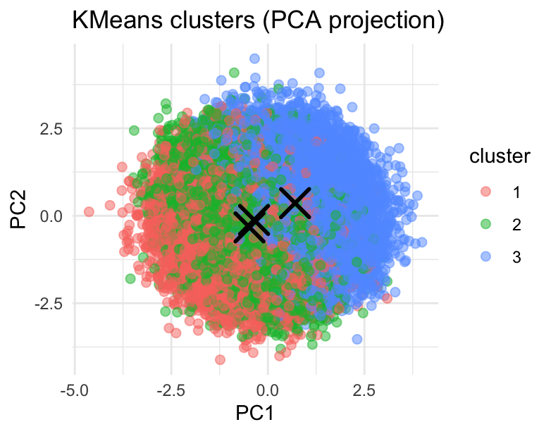
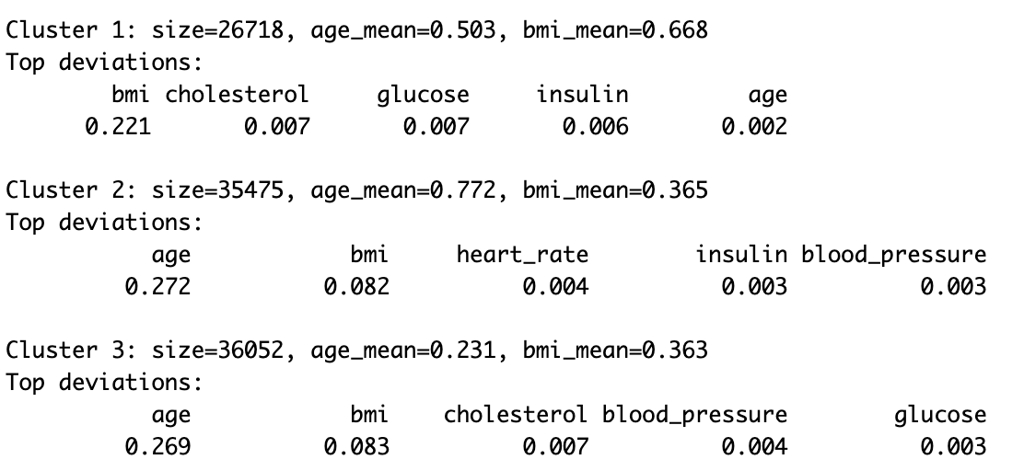
K-means Clustering
Not a good method for clustering this dataset
Used elbow method to get k=3
PC1: age, cardiovascular indicators
PC2: glucose, metabolic health variations
Notes:
Not a good method for clustering this dataset
Highly correlated variables
Assumes spherical cluster shapes

Slide 15
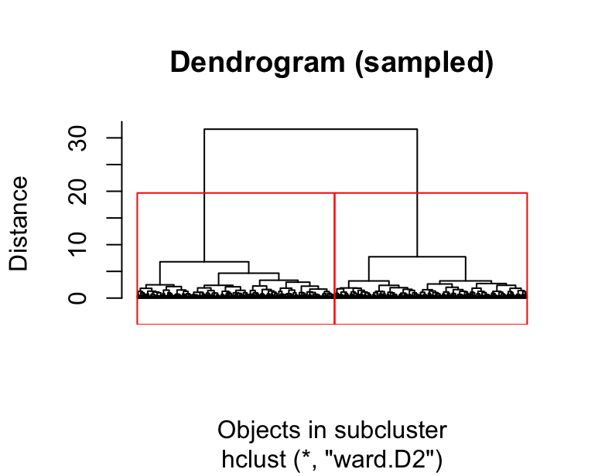
Hierarchical Clustering
Sample of n=5000 from whole dataset
  Make it easier to see structure
Dendrogram- selected k=2

Slide 16
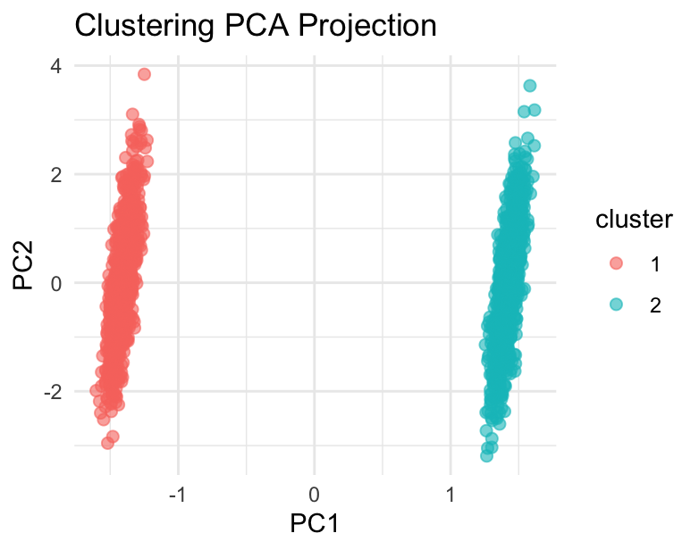
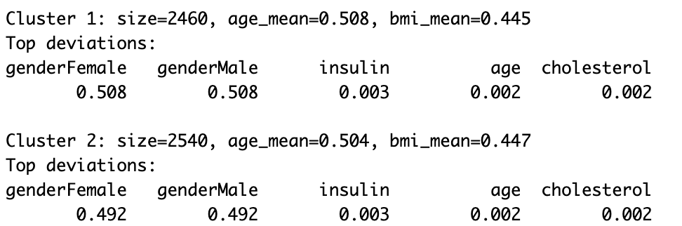
Hierarchical Clustering
2 clusters
Not spherically shaped
Similar age and BMI distributions between the clusters
Clusters equal in size, similarly distributed around age and bmi
PC1: Gender
PC2: BMI

Slide 17
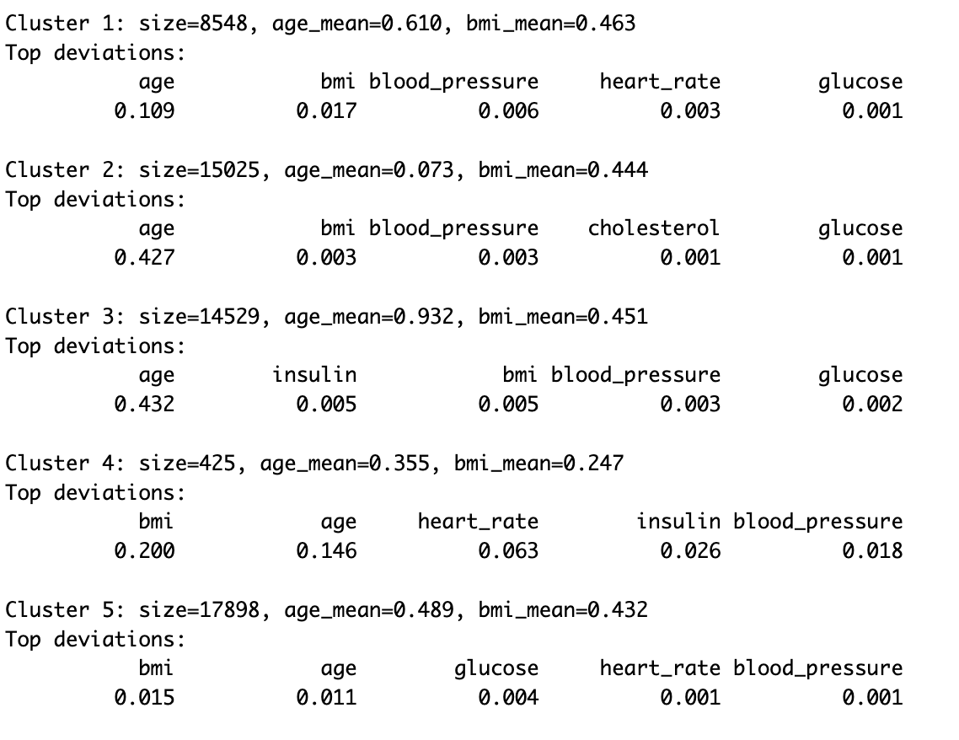
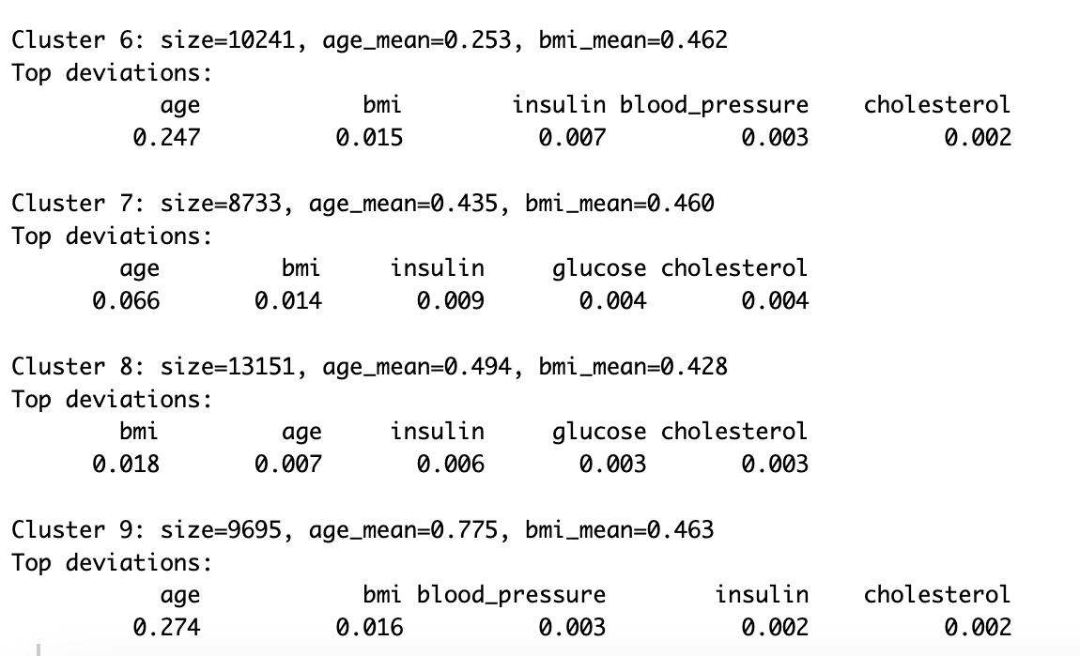
Gaussian Mixture Model
GMM models data as overlapping Gaussian clusters and assigns points probabilistically using expectation maximization
9 clusters; Size of clusters varies from 425 to 17898
PCA 1: Top features are age, cholesterol, blood pressure
PCA 2: Top features are glucose, cholesterol, insulin

Slide 18


Conclusion
Classification models
Clustering Methods
Limitations and Improvements
Random forest model performs the best in terms of time and computational cost.
GMM captured the best subgroup structures. Across all clustering, age, BMI, and metabolic indicators were the strongest drivers of clustering
Future work should include feature selection, dimensionality reduction beyond PCA, or deep learning methods to better handle complex health datasets.
Working hours, BMI, heart rate and cholesterol level are the most important features that factor the health status
Clustering health data is difficult due to high dimensionality and high correlation between features
In health analytics, poor feature quality or imbalance can directly distort risk predictions

Slide 19

Questions?
Thank you!
PRESENTATION TITLE | THE UNIVERSITY OF ARIZONA

